Slide 1
Chapter 9 Introduction to HTML and Applets
Fundamentals of Java: AP Computer Science Essentials, 4th Edition
Lambert / Osborne

Slide 2
Objectives
Describe the basic features of hypertext, hypermedia, and the World Wide Web.
Use basic HTML markup tags to format text for a Web page.
Construct an HTML list and an HTML table to represent a linear sequence of items and a two-dimensional grid of items, respectively.
‹#›
‹#›

Slide 3
Objectives (continued)
Use the appropriate markup tags to include images in Web pages.
Create links to other Web pages using absolute or relative path names.
Convert a Java application to an applet and embed the applet in a Web page.
List the constraints on applets that distinguish them from Java applications.
‹#›
‹#›

Slide 4
Vocabulary
absolute path name
associative link
definition list
external image
hyperlinks
hypermedia
hypertext
hypertext markup language (HTML)
inline image
markup tag
memex
relative path name
uniform resource locator (URL)
‹#›
‹#›

Slide 5
Hypertext, Hypermedia, and the World Wide Web
Vannevar Bush:
Scientist at MIT in 1945.
Predicted that computers would be used for data storage and manipulation, and logical reasoning.
Predictions came true in 1950s and 60s with new branches of computer science.
Database management
Artificial intelligence
‹#›
‹#›

Slide 6
Hypertext, Hypermedia, and the World Wide Web (continued)
Bush also asked how to improve ways to consult information during research.
Proposed linking information associatively.
Table or keyed list: data structure that allows a computer to look up an item associated with a key.
Memex: would receive information from copy machine, keyboard or stylus from microfilm.
Computer would maintain associative links and the user’s exploration of them.
‹#›
‹#›

Slide 7
Hypertext, Hypermedia, and the World Wide Web (continued)
Hypertext and Hypermedia:
1967, Theodor Holm Nelson coined the term hypertext to refer to Bush’s machine.
Hypertext: structure of nodes and links.
Each node is a document or chunk of text.
1987, Apple released Hypercard.
A hypermedia platform.
GUIs, images, sound, animation, applications.
‹#›
‹#›

Slide 8
Hypertext, Hypermedia, and the World Wide Web (continued)
Networks and the World Wide Web:
World Wide Web: pages stored on different machines around the world, used to share hypertext across a network.
Servers: store pages of information.
Clients: run browsers to access information on servers.
‹#›
‹#›

Slide 9
Hypertext, Hypermedia, and the World Wide Web (continued)
Networks and the World Wide Web (cont):
Clients and servers can be the same machine.
When you select a link:
Browser sends a message to request information transfer from the node’s machine.
If successful, information is downloaded to user’s browser.
‹#›
‹#›

Slide 10
Hypertext, Hypermedia, and the World Wide Web (continued)
Networks and the World Wide Web (cont):
A networked hypermedia system requires a uniform means of:
Representing information using machine-independent hypertext markup language.
Assigning node addresses using machine-independent uniform resource locators (URLs).
Transmitting information using machine-independent network protocols.
Displaying information with browsers from different vendors.
‹#›
‹#›

Slide 11
Overview of Hypertext Markup Language
HTML: machine-independent way of representing information in a network-based hypermedia system.
Markup tags: codes that indicate the format of textual elements or links to other nodes.
Browsers interpret codes as commands and display text in desired format.
‹#›
‹#›

Slide 12
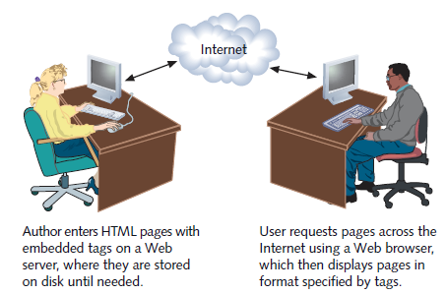
Overview of Hypertext Markup Language (continued)
The Internet
‹#›
‹#›

Slide 13
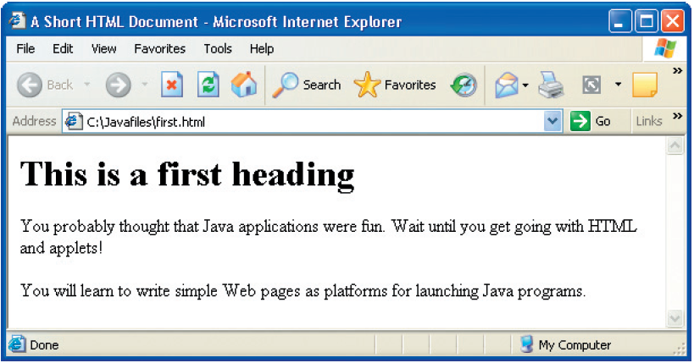
Overview of Hypertext Markup Language (continued)
Includes markups for: title, heading, two paragraphs of text.
A simple Web page
‹#›
‹#›

Slide 14

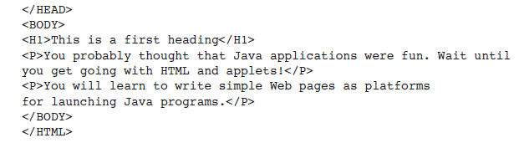
Overview of Hypertext Markup Language (continued)
Code for Figure 9-2:
‹#›
‹#›

Slide 15
Overview of Hypertext Markup Language (continued)
When the browser displays the document:
Title appears at the top of browser window.
Blank line between the heading and first paragraph and between two paragraphs.
Browser wraps words to fit text within window.
HTML documents typically consist of multiple HTML pages.
File extension .html (UNIX) and .htm (Windows).
Pages can be any size.
‹#›
‹#›

Slide 16
Overview of Hypertext Markup Language (continued)
Markup Tags:
A markup tag begins with < and ends with >.
Not case-sensitive, but upper-case is used for readability.
Tags usually occur in pairs.
Opening tag: tells where to start format.
Closing tag: begins with / and tells where to end.
Tags can include attributes, such as align center.
‹#›
‹#›

Slide 17
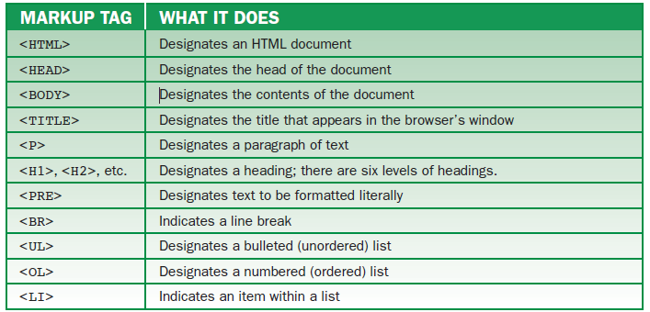
Overview of Hypertext Markup Language (continued)
Basic HTML markup tags
‹#›
‹#›

Slide 18
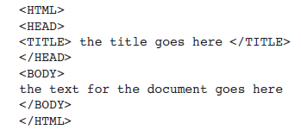
Overview of Hypertext Markup Language (continued)
Minimal Document Structure:
Every HTML document should have the following:
<HTML>: tells browser file is HTML.
<HEAD>: identifies first part of document.
‹#›
‹#›

Slide 19
Overview of Hypertext Markup Language (continued)
Minimal Document Structure (cont):
<TITLE>: title displays at top of browser window and is used during searches for document.
Short, descriptive titles are best.
<BODY>: information in the document.
Browsers ignore extra white space.
Blank lines, tab characters.
‹#›
‹#›

Slide 20
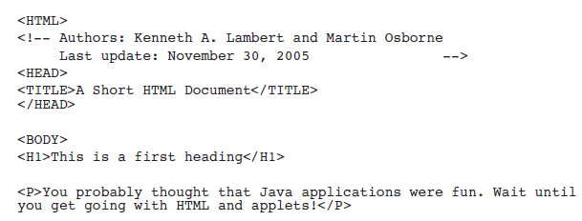
Overview of Hypertext Markup Language (continued)
Commenting an HTML Document:
Browsers do not interpret or display comments.
‹#›
‹#›

Slide 21
Simple Text Elements
Headings:
Six levels (H1 to H6).
Different font size and style from normal text.
Blank line after each heading.
Paragraphs:
Left, right, or center alignments.
If the end tag </P> is omitted, browser ends paragraph at the beginning of next paragraph or heading tag.
‹#›
‹#›

Slide 22
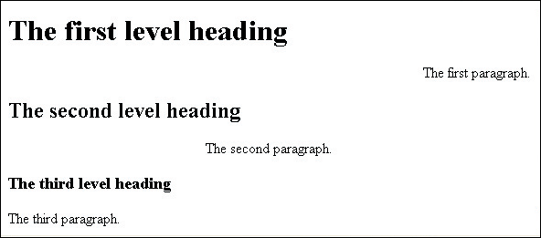
Simple Text Elements (continued)
Paragraphs (cont):
Word wrap is used to fit paragraphs within browser’s window borders.
Headings and paragraphs coded with HTML
‹#›
‹#›

Slide 23

Simple Text Elements (continued)
Forced Line Breaks:
<BR> tag displays lines of text without word wrap.
<BR> at end of line; no other end tag needed.
Preformatted Text:
Displays text with line breaks, extra spaces, and tabs.
‹#›
‹#›

Slide 24
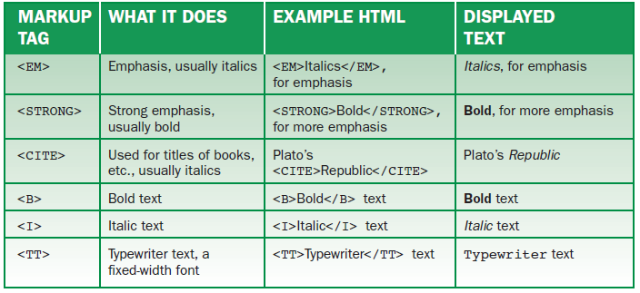
Character-Level Formatting
Some character format tags
‹#›

Slide 25
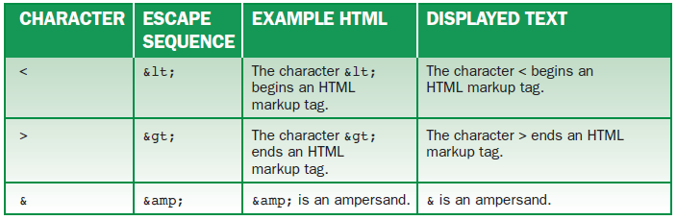
Character-Level Formatting (continued)
Escape Sequences:
For < and > tags: lt is less than; gt is greater than.
‹#›
‹#›

Slide 26
Lists
Unordered (bulleted) lists: <UL>
Numbered (ordered) lists: <OL>
Definition (association) lists: <DL>
To create bulleted and numbered lists:
Start with list tag <UL> or <OL>.
For each item, use <LI> starting tag, then text.
End with list tag </UL> or </OL>.
‹#›
‹#›

Slide 27
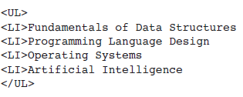
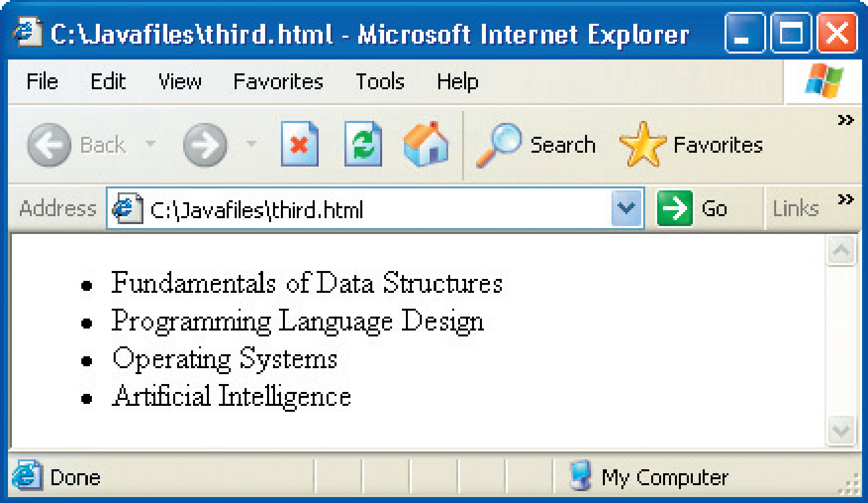
Lists (continued)
An Unordered List Example:
An unordered (bulleted) list
‹#›
‹#›

Slide 28
Lists (continued)
A Definition List Example:
Definition list: displays terms and their associated definition.
<DL> begins and ends the list.
<DT> precedes each term.
<DD> precedes each definition.
‹#›
‹#›

Slide 29
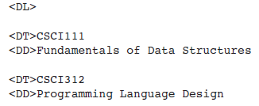
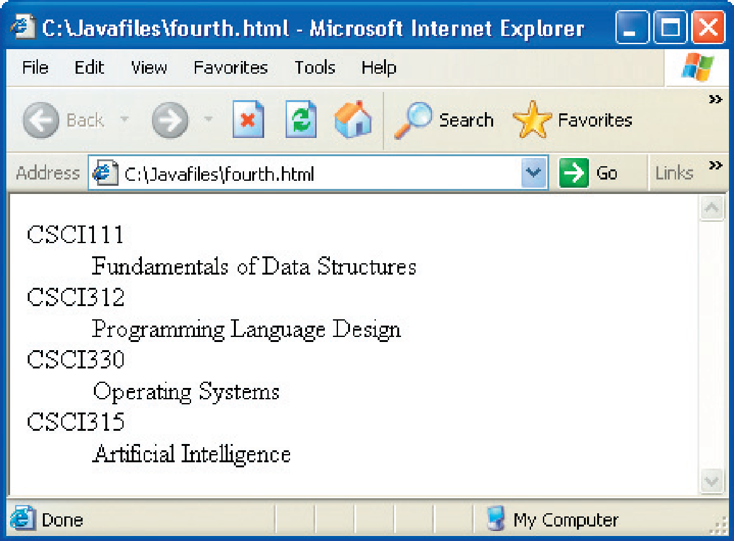
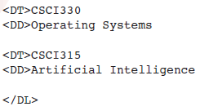
Lists (continued)
A Definition List Example (cont):
‹#›
‹#›

Slide 30
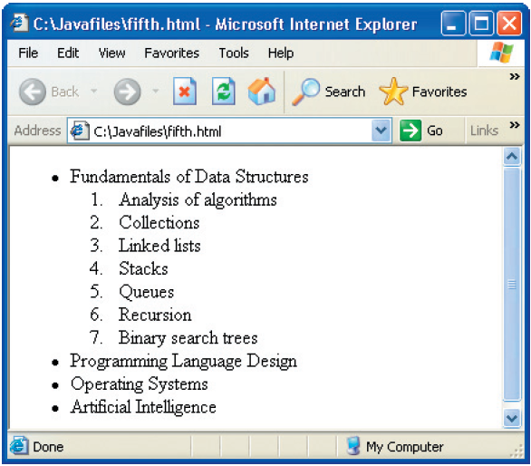
Lists (continued)
A Nested List Example:
Lists can be nested within other lists.
More than three levels can be difficult to read.
‹#›
‹#›

Slide 31
Linking to Other Documents
Hyperlinks: also called links, hypertext references, allow readers to move to other pages in the Web.
<A>: stands for anchor.
To place a link in an HTML document:
Identify the target document (path name or URL).
Determine text that labels the link in the browser.
Place the information in an anchor:
‹#›
‹#›

Slide 32
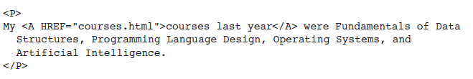
Linking to Other Documents (continued)
Links or anchors can appear within any HTML element.
Often embedded as list items or terms in a paragraph.
Example links to a file courses.html:
‹#›
‹#›

Slide 33
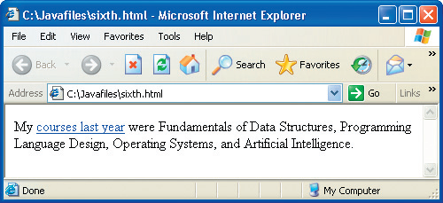
Linking to Other Documents (continued)
A link to another page
‹#›
‹#›

Slide 34
Linking to Other Documents (continued)
Path Names:
Location of target document.
Absolute path name: position in a computer’s directory structure.
Relative path name: location relative to the currently displayed document.
Easier to use because they are shorter and don’t need to be changed when a group of documents is moved.
‹#›
‹#›

Slide 35
Linking to Other Documents (continued)
URLs:
URLs are used to locate a target document located on another server in the network.
Format for a URL to another Web site (the host):
Example:
‹#›
‹#›

Slide 36

Multimedia
Inline Images:
Inline images are graphical images that display when the user opens a page.
GIF (.gif) or JPEG (.jpg, .jpeg) formats.
Size attributes: height and width in pixels.
‹#›
‹#›

Slide 37

Multimedia (continued)
Inline Images (cont):
Alignment: position of text relative to image.
By default, text following an image starts at image’s lower-right corner.
To detach an image from text, place it in a separate paragraph.
‹#›
‹#›

Slide 38
Multimedia (continued)
External Images:
External images are not displayed until a user clicks a link.
Faster download time for document.
Link can be a string of text or a thumbnail (smaller version of image).
‹#›
‹#›

Slide 39
Multimedia (continued)
Colors and Backgrounds:
Background, text, and link colors are controlled by BGCOLOR, TEXT, and LINK attributes of <BODY> tag.
String of three two-digit hexadecimal numbers specifies a color by indicating RGB components.
Can also use an image as a page background.
Small images can be tiled: repeated across and down.
‹#›
‹#›

Slide 40
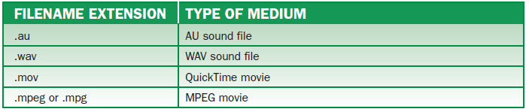
Multimedia (continued)
Other Media:
Some hypermedia filename extensions
‹#›
‹#›

Slide 41
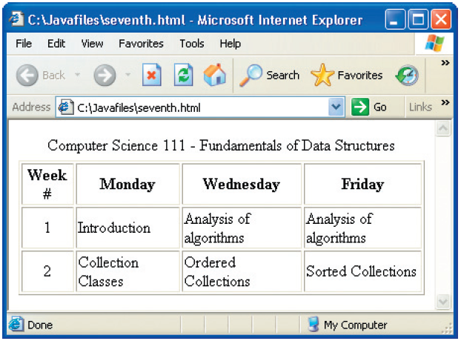
Tables
A table
‹#›
‹#›

Slide 42
Tables (continued)
Tables usually contain the following elements:
Caption or title at the top.
First row: column headers, describing column data.
Rows of data. Cells can contain any HTML elements (text, images, links, etc.).
‹#›
‹#›

Slide 43
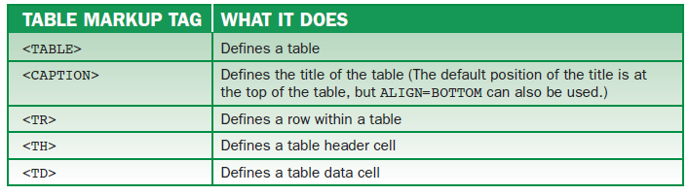
Tables (continued)
Table format tags
‹#›
‹#›

Slide 44
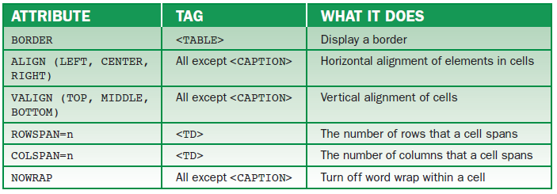
Tables (continued)
Table attributes
‹#›
‹#›

Slide 45
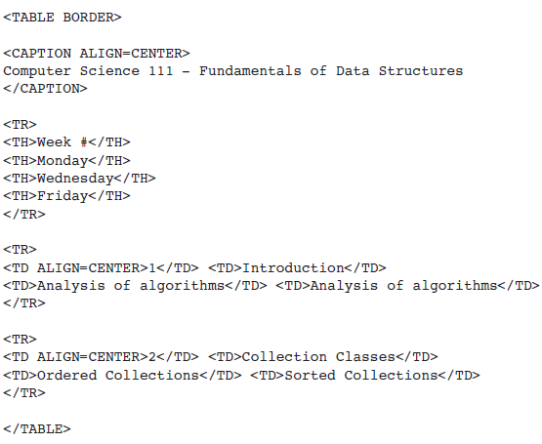
Tables (continued)
Typical Table Format:
Blank lines increase readability, but do not affect display.
‹#›
‹#›

Slide 46
Applets
Applet: Java application that runs in a Web page as a GUI.
Two components:
HTML document with an applet markup tag.
Byte code file for the applet: a compiled Java applet in a .class file.
‹#›
‹#›

Slide 47
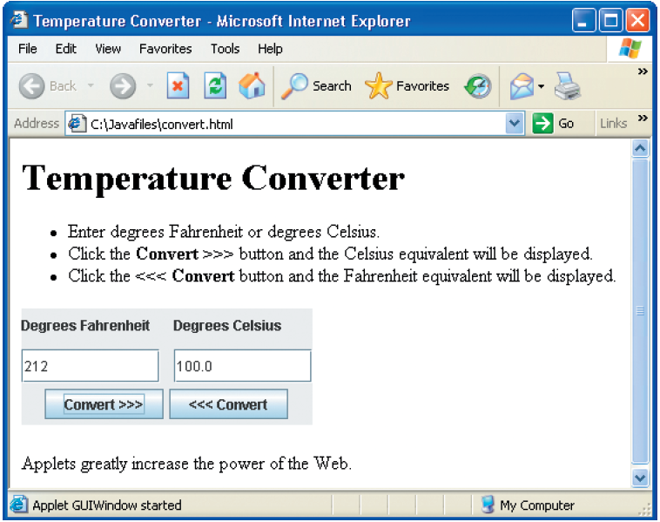
Applets (continued)
An applet within a Web page
‹#›
‹#›

Slide 48
Applets (continued)
Converting an Application to an Applet:
Replace the name JFrame with JApplet at the beginning of the class definition.
Replace the class’s constructor with the method init:
‹#›
‹#›

Slide 49
Applets (continued)
Using the Applet Viewer:
Allows programmer to run an applet and view its GUI (not Web page).
Comes with Sun’s JDK.
To use the applet viewer:
Compile Java source program as usual.
Create HTML file with at least the minimal applet tag.
At the command line prompt, run the following command:
‹#›
‹#›

Slide 50
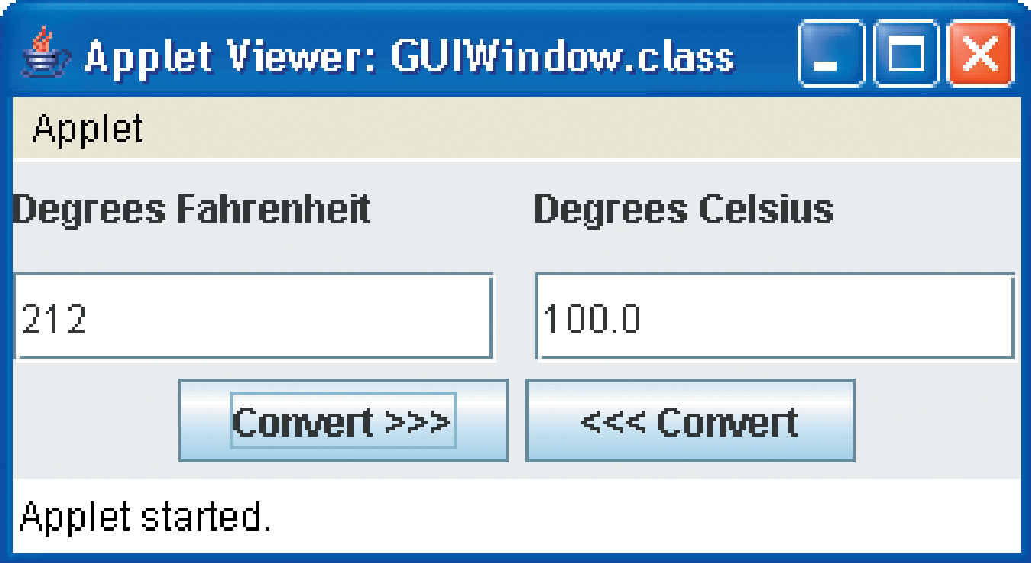
Applets (continued)
Using the Applet Viewer (cont):
An applet within the applet viewer
‹#›
‹#›

Slide 51
Applets (continued)
Constraints on Applets:
To ensure security, applets cannot access files on the user’s machine.
Applets and their HTML documents should be in the same directory.
The programs in this book use Java 6.0; only Web browsers that support Java 6.0 can be used.
‹#›
‹#›

Slide 52
Applets (continued)
Constraints on Applets (cont):
The technique for using dialog boxes for applets is the same as applications, except:
The parent parameter of the dialog box’s constructor should be null (not the applet).
You might see a warning message in the dialog box.
The dialog box does not prevent you from returning to the Web page. Once there, you cannot interact with the applet, but you can browse to other pages and more.
‹#›
‹#›

Slide 53
Applets (continued)
Loading Images into Applets:
Images must reside on the Web server from which the applet’s byte code was sent.
JApplet method getDocumentBase () locates and returns URL of applet’s Web server.
JApplet method getImage expects the URL and filename of an image as parameters.
Downloads image from Web server and returns an object of the class Image.
‹#›
‹#›

Slide 54
Applets (continued)
Passing Parameters to Applets:
It is possible to send information from an HTML page to an applet.
Information is passed in HTML parameter tags and retrieved in the applet’s code.
The parameter tag must appear between the opening and closing applet tags.
The method getParameter can retrieve the parameter’s value as a string.
‹#›
‹#›

Slide 55
Summary
In this chapter, you learned:
The World Wide Web is a hypermedia system that allows users to navigate among and use various resources in a nonlinear manner.
HTML tags can be used to format text for Web pages. Other markup tags can be used to organize information in lists and tables in a Web page.
Links to other pages using absolute or relative path names also can be included in HTML elements.
‹#›
‹#›

Slide 56
Summary (continued)
Web pages also can contain applets or Java applications that are downloaded from a Web server and run in the user’s Web browser.
There are a few simple steps to convert a Java application to an applet. Applets have most of the functionality of applications, including the GUI, but they lack file access to the user’s disks.
‹#›
‹#›

